Slide 1

SORTING, GRADING AND QUALITY CONTROL OF NUTS USING AI AND IMAGE PROCESSING TECHINQUES
GUIDE NAME:
Dr.G.D.ANBARASI JEBASELVI,M.E., Ph.D.,
ASSOCIATE PROFESSOR
DEPARTMENT OF ECE
TEAM MEMBERS:
SUJAY SARVESH KK (41130540)
NANDHA S (41130709)

Slide 2
Abstract:
The existence of conversion industries to sort and grade almonds with modern technology plays a vital role in export.
Since most of the almonds produced in Iran are exported to domestic and foreign markets without sorting and grading, it is necessary to have a well-functioning smart system to create added value, reduce waste, increase shelf life, and provide better product delivery.
In this study, a method is introduced to sort and grade almonds by integrating image deep learning and artificial neural network techniques.
A system was designed and developed in which the image processing capabilities of Python were harnessed to build an AI model for nut detection. The proposed system utilizes advanced image recognition algorithms to classify almonds accurately, reducing human error and enhancing efficiency competitiveness.
KEY WORDS:
Almonds sorting, Image deep learning, Artificial neural networks, Nut detection, Python AI model, Automated grading, Export quality

Slide 3
The AI model processes images captured by cameras, identifying and sorting nuts based on predefined criteria.
This automated approach not only improves sorting accuracy but also boosts productivity by minimizing manual intervention.
The integration of deep learning and neural networks in this system represents a significant advancement in the nut processing industry, ensuring high-quality output and better market

Slide 4
Existing System:
Existing systems relying on conventional methods often struggle with low accuracy in nut classification, leading to frequent sorting errors.
Previous systems require substantial manual intervention for sorting, resulting in inefficiencies and increased labor costs
Existing System Drawback:
Existing systems often suffer from inconsistent sorting results due to reliance on less advanced algorithms or manual methods.
Manual or semi-automated systems require significant human effort for sorting, increasing operational costs and reducing overall efficiency

Slide 5
Proposed System:
The IR sensor detects the presence of nuts on the conveyor belt, prompting the ATmega 328 microcontroller to stop the conveyor for individual analysis.
The AI deep learning model classifies each nut based on its variety, directing the servo motor to sort the nuts into designated bins according to the classification results
Proposed System Advantages:
The AI deep learning model enhances classification precision, reducing human error and ensuring each nut is sorted accurately based on variety.
Automated detection and sorting streamline the process, minimizing manual intervention and improving overall productivity in nut processing

Slide 6
Scope of the project:
The scope of this project encompasses the development and implementation of an automated nut sorting system utilizing an ATmega 328 microcontroller and a deep learning AI model. It involves designing a conveyor belt equipped with an IR sensor for detecting nuts, integrating image processing capabilities to classify nuts based on variety, and employing a servo motor for precise sorting into designated bins. The project aims to enhance efficiency, accuracy, and productivity in nut handling processes by minimizing manual intervention and reducing sorting errors. Additionally, it offers scalability for various nut types and potential expansion into other automated sorting applications

Slide 7
Literature survey:
Title 1: SORTING OF IN‐SHELL PISTACHIO NUTS FROM KERNELS USING COLOR IMAGING
Authors: R. P. Haff, T. C. Pearson, N. Toyofuku.
Year: 2019
Description:
Sorting pistachio kernels from in‐shell nuts currently requires a combination of automated and manual sorting, an expensive and labor‐intensive two‐stage process. This research demonstrates the feasibility of using color imaging as a basis for distinguishing both regular and small in‐shell pistachio nuts from kernels in the pistachio nut process stream. Two algorithms were developed to classify images of in‐shell nuts, small in‐shell nuts, and kernels. The first algorithm used a discriminant analysis (DA) routine to evaluate features extracted from the images based on histograms of red, green, and blue (RGB) pixel intensities, and resulted in a 99.9% overall accuracy for separating regular in‐shell pistachio nuts from kernels. Small in‐shell pistachio nuts were harder to discriminate from kernels, with an overall accuracy of 85%. The second algorithm used a k‐nearest neighbors (knn) routine to evaluate features based on color histograms plus intensity slope information. The knn routine matched the accuracy of the DA algorithm for distinguishing regular in‐shells from kernels with 99.9% correct. For the small in‐shell case, however, the knn approach was superior with 96% accuracy. When used in a high‐speed color imaging system, the algorithms would provide the means for economical high‐speed sorting of in‐shell pistachio nuts and kernels

Slide 8
Title 2: Separating in-shell pistachio nuts from kernels using impact vibration analysis
Authors: Ron P. Haff , T. C. Pearson
Year: 2019
Description:
A sorting system has been developed for the separation of small in-shell pistachio nuts from kernels without shells on the basis of vibrations generated when moving samples strike a steel plate. Impacts between the steel plate and the hard shells, as measured using an accelerometer attached to the bottom of the plate, produce higher frequency signals than impacts between the plate and the kernels. Signal amplitudes, on the other hand, were highly variable and by themselves were not useful for the separation of samples. An algorithm was developed using both amplitude and frequency information to classify the signals. The algorithm activated an air nozzle to divert inshell nuts away from the kernel stream. A prototype sorter was tested at throughput rates of 0.33, 10, 20, and 40 nuts per second using a mix of 10% in-shell and 90% kernels. At the lowest throughput rate, classification accuracies were 96% for in-shell nuts and 99% for kernels. For throughput rates between 10 and 40 nuts/s, correct classification ranged from 84 to 90% for in-shell nuts. For kernels, a

Slide 9
Title 3: Hardware-based image processing for high-speed inspection of grains.
Authors: Tom Pearson
Year: 2019
Description:
A high-speed, low-cost, image-based sorting device was developed to detect and separate grains having slight color differences or small defects. The device directly combines a complementary metal–oxide–semiconductor (CMOS) color image sensor with a field-programmable gate array (FPGA) which was programmed to execute image processing in real-time, without the need of an external computer. Spatial resolution of the imaging system is approximately 16 pixels/mm. The system includes three image sensor/FPGA combinations placed around the perimeter of a single-file stream of kernels, so that most of the surface of each kernel is be inspected. A vibratory feeder feeds kernels onto an inclined chute that kernels slide down in a single-file manner. Kernels are imaged immediately after dropping off the end of the chute and are diverted by activating an air valve. The system has a throughput rate of approximately 75 kernels/s per channel which is much higher than previously developed image inspection systems. This throughput rate corresponds to an inspection rate of approximately 8 kg/h of wheat and 40 kg/h of popcorn. The system was initially developed to separate white wheat from red wheat, and to remove popcorn having blue-eye damage, which is indicated by a small blue discoloration in the germ of a popcorn kernel. Testing of the system resulted in accuracies of 88% for red wheat and 91% for white wheat. For popcorn, the system achieved 74% accuracy when removing popcorn with blue-eye damage and 91% accuracy at recognizing good popcorn. The sorter should find uses for removing other defects found in grain, such as insect-damaged grain, scab-damaged wheat, and bunted wheat. Parts for the system cost less than $2000, suggesting that it may be economical to run several systems in parallel to keep up with processing plant rates.

Slide 10
Title 4: HYPERSPECTRAL IMAGE DATA MINING FOR BAND SELECTION IN AGRICULTURAL APPLICATIONS
Authors: S. G. Bajwa, P. Bajcsy, P. Groves, L. F. Tian
Year: 2019
Description:
Hyperspectral remote sensing produces large volumes of data, quite often requiring hundreds of megabytes to gigabytes of memory storage for a small geographical area for one−time data collection. Although the high spectral resolution of hyperspectral data is quite useful for capturing and discriminating subtle differences in geospatial characteristics of the target, it contains redundant information at the band level. The objective of this study was to identify those bands that contain the most information needed for characterizing a specific geospatial feature with minimal redundancy. Band selection is performed with both unsupervised and supervised approaches. Five methods (three unsupervised and two supervised) are proposed and compared to identify hyperspectral image bands to characterize soil electrical conductivity and canopy coverage in agricultural fields. The unsupervised approach includes information entropy measure and first and second derivatives along the spectral axis. The supervised approach selects hyperspectral bands based on supplemental ground truth data using principal component analysis (PCA) and artificial neural network (ANN) based models. Each hyperspectral image band was ranked using all five methods. Twenty best bands were selected by each method with the focus on soil and plant canopy characterization in precision agriculture. The results showed that each of these methods may be appropriate for different applications. The entropy measure and PCA were quite useful for selecting bands with the most information content, while derivative methods could be used for identifying absorption features. ANN measure was the most useful in selecting bands specific to a target characteristic with minimum information redundancy. The results also indicated that a combination of wavebands with different bandwidths will allow use of fewer than 20 bands used in this study to represent the information contained in the top 20 bands, thus reducing image data dimensionality and volume considerably.

Slide 11
Title 5: IDENTIFICATION OF INSECT DAMAGED WHEAT KERNELS USING TRANSMITTANCE IMAGES.
Authors : Zehra Cataltepe , Enis Cetin, Tom Pearson.
Year: 2020
Description:
We used transmittance images and different learning algorithms to classify insect damaged and un-damaged wheat kernels. Using the histogram of the pixels of the wheat images as the feature, and the linear model as the learning algorithm, we achieved a False Positive Rate (1-specificity) of 0.2 at the True Positive Rate (sensitivity) of 0.8 and an Area Under the ROC Curve (AUC) of 0.86. Combining the linear model and a Radial Basis Function Network in a committee resulted in a FP Rate of 0.1 at the TP Rate of 0.8 and an AUC of 0.92.

Slide 12
Working Principle:
In this project, an ATmega 328 microcontroller serves as the central controller for a nut sorting and qualifying system powered by an AI deep learning model. The primary objective is to efficiently sort and classify nuts based on their variety using advanced technology. The system is equipped with an IR sensor positioned above the conveyor belt, which detects the presence of nuts as they move along the belt. Upon detection, the IR sensor signals the ATmega 328 to halt the conveyor, allowing each nut to be analyzed individually. The deep learning AI model, integrated into the system, processes images of the nuts classifies them according to their type. This classification is then communicated to a servo motor, which performs the sorting action based on the nut's variety. The servo motor is responsible for directing the nuts into the appropriate bins or channels for further processing. This approach ensures precise sorting, enhancing efficiency and accuracy in the nut handling process. By leveraging the capabilities of the ATmega 328 microcontroller and the deep learning model, the project achieves a streamlined and automated solution for nut sorting and qualification, optimizing operational productivity and quality control

Slide 13
Block Diagram:
POWER SUPPLY
SERVO MOTOR (3)
LCD
Atmega 328
CONVEYOR MECHANISM
IR SENSOR
RS232 CABLE
MOTOR DRIVER
CAMERA

Slide 14
Block Diagram Process
Content: The system flow in the block diagram automates the detection, analysis, and sorting of objects using the following steps:
Power Supply Activation: Provides energy to all connected components (Atmega 328 microcontroller, LCD, motor driver, IR sensor), initializing the system.
IR Sensor Detection: The IR sensor detects objects on the conveyor and sends a signal to the Atmega 328 microcontroller, indicating that an object is in position.
Conveyor Mechanism Movement: Upon receiving the IR sensor’s signal, the microcontroller activates the conveyor mechanism to move the object to the inspection area, ensuring it is properly positioned for image capture and analysis.
Camera Capture & Image Processing: The camera captures an image of the object when it reaches the inspection area. The image data is processed by Python software to perform object detection, sorting, or quality control. Algorithms, including machine learning or computer vision techniques, analyze the captured image.

Slide 15
Microcontroller Processing: The Atmega 328 microcontroller interprets the processed data from Python and determines the required action based on the analysis. If necessary, it communicates with other components through the RS232 cable for coordination.
Motor Driver & Servo Motor Control: The motor driver receives instructions from the microcontroller to control servo motors, positioning or moving the object as required for sorting, defect removal, or placement in a specific area.
LCD Display: Provides real-time feedback on the object’s processing status, displaying sorting or inspection results to keep operators informed.
Process Looping: After one object is processed, the IR sensor awaits the next object on the conveyor. The process repeats, allowing for continuous, automated sorting, inspection, or quality control.
Summary: This flow enables efficient, automated handling of objects on the conveyor system, managed by the Atmega 328 microcontroller and Python-based image processing, ensuring high-speed, real-time processing for sorting or inspection.

Slide 16
Module Name:
Detection and Control Module
Image Processing and Classification Module
Sorting and Actuation Module
Algorithms:
DETECTION AND CONTROL MODULE:
This module is responsible for the detection of nuts on the conveyor belt and the control of the sorting process. It includes an IR sensor positioned above the conveyor belt to detect the presence of nuts as they move along. The ATmega 328 microcontroller is central to this module, receiving signals from the IR sensor to halt the conveyor belt when a nut is detected. The module ensures precise timing and coordination of the sorting process

Slide 17
POWER SUPPLY
LCD
IR SENSOR
MOTOR DRIVER
Atmega 328
CONVEYOR MECHANISM

Slide 18
IMAGE PROCESSING AND CLASSIFICATION MODULE:
This module utilizes a deep learning AI model to process and classify nuts by analyzing high-resolution images captured once the nuts are stationary on the conveyor belt. The AI model, integrated into the system, performs image analysis to identify and categorize each nut based on its type. After classification, the model generates data that is sent to the control module. This data informs the control module of the nut's variety, allowing it to direct the sorting process with precision. By effectively processing and classifying each nut, this module ensures accurate sorting and efficient handling, contributing significantly to the overall performance and productivity of the nut sorting system
POWER SUPPLY
LCD
RS232 CABLE
Atmega 328

Slide 19
SORTING AND ACTUATION MODULE:
The Sorting and Actuation Module is responsible for the physical sorting of nuts based on the classification results provided by the AI model. This module features a servo motor that is crucial for directing the sorted nuts into designated bins or channels. Once the AI model classifies each nut, the classification data is communicated to this module, where the servo motor receives commands from the ATmega 328 microcontroller. The servo motor then precisely moves to guide each nut into the correct bin or channel corresponding to its variety. This ensures that nuts are accurately sorted according to their type, facilitating efficient collection and further processing. The precise movements of the servo motor are vital for maintaining sorting accuracy and operational efficiency, minimizing errors and maximizing productivity in the nut handling process. This module integrates seamlessly with the detection and image processing modules, completing the automated sorting system and optimizing the overall workflow
POWER SUPPLY
SERVO MOTOR (3)
Atmega 328

Slide 20
Hardware Requirement:
POWER SUPPLY
LCD
ATMEGA 328
CONVEYOR MECHANISM
SERVO MOTOR
IR SENSOR
RS232 CABLE
CAMERA

Slide 21
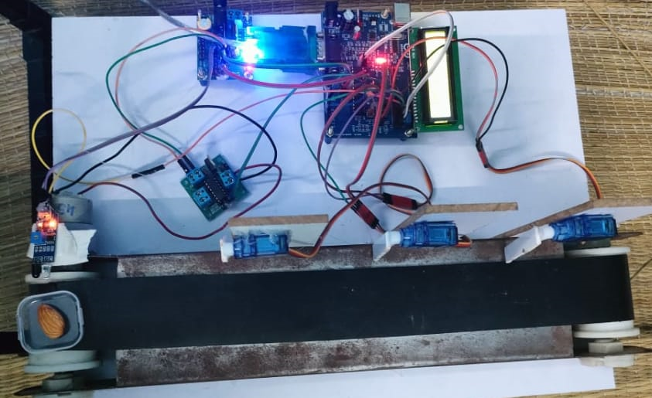
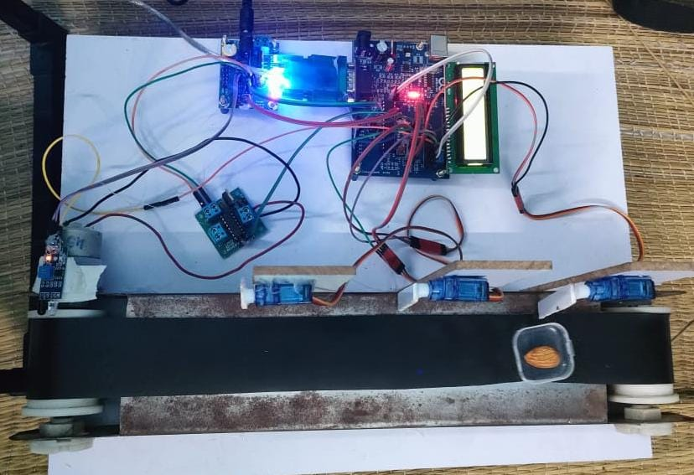
PROJECT SCREEN SHOT:

Slide 22
Software Requirement:
ARDUINO IDE
EMBEDDED C
PYTHON
Application:
Automated Nut Processing Plants: The proposed system can be integrated into industrial nut processing facilities to enhance sorting efficiency, accurately classify various nut types, and reduce manual labor, thus improving production speed and consistency.
Quality Control in Food Manufacturing: By implementing this system, food manufacturers can ensure higher quality standards by accurately sorting and qualifying nuts based on variety, leading to better product quality and reduced waste.

Slide 23
Future Enhancement:
Future enhancements for this nut sorting and qualifying system can be significantly advanced by integrating a Raspberry Pi alongside the ATmega 328 microcontroller. By incorporating a Raspberry Pi, the system can leverage its superior processing power and advanced connectivity options to enhance the deep learning AI model’s capabilities. The Raspberry Pi can handle more complex image processing tasks and run a more sophisticated version of the AI model, potentially increasing classification accuracy and speed. Additionally, the Raspberry Pi's ability to connect to the internet can facilitate real-time data analytics and remote monitoring, allowing operators to oversee the sorting process from any location and make adjustments or updates to the AI model as needed. Integration with cloud-based services can also enable continuous model training and improvement based on new data. Furthermore, the Raspberry Pi can support additional features such as a user-friendly graphical interface for system management, automated diagnostics, and enhanced data logging. These improvements would not only streamline the sorting process but also provide valuable insights into system performance, contributing to ongoing optimization and innovation in nut sorting technology.

Slide 24
Conclusion:
In conclusion, the integration of an ATmega 328 microcontroller with a deep learning AI model for nut sorting and qualification represents a significant advancement in automated processing technology. This system achieves precise sorting by combining real-time nut detection with sophisticated image classification, enhancing both efficiency and accuracy. The use of an IR sensor to detect nuts and a servo motor for sorting ensures that each nut is correctly classified and directed to its respective bin or channel, minimizing manual intervention and errors. The future potential for this system is further amplified by incorporating a Raspberry Pi, which can offer increased processing power, advanced connectivity, and the ability to run more complex AI models. This integration would enable real-time monitoring, cloud-based data analytics, and ongoing model improvements, driving continuous optimization of the sorting process. Overall, this project not only demonstrates the effective application of modern technology in industrial automation but also sets the stage for future innovations that could enhance operational productivity and quality control in nut handling and beyond. The combination of precise hardware and advanced AI offers a streamlined solution for efficient nut sorting, with potential for broader applications in various automated systems.

Slide 25
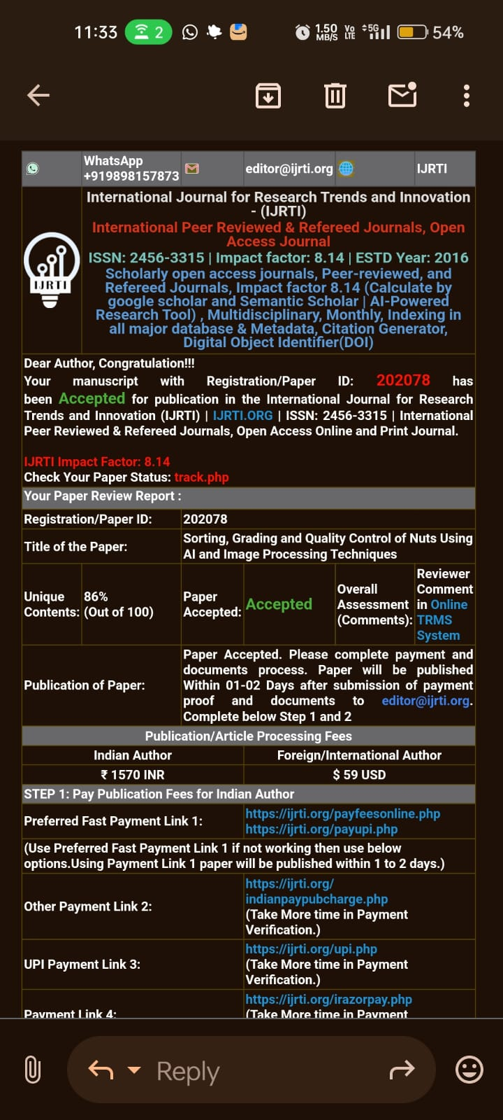
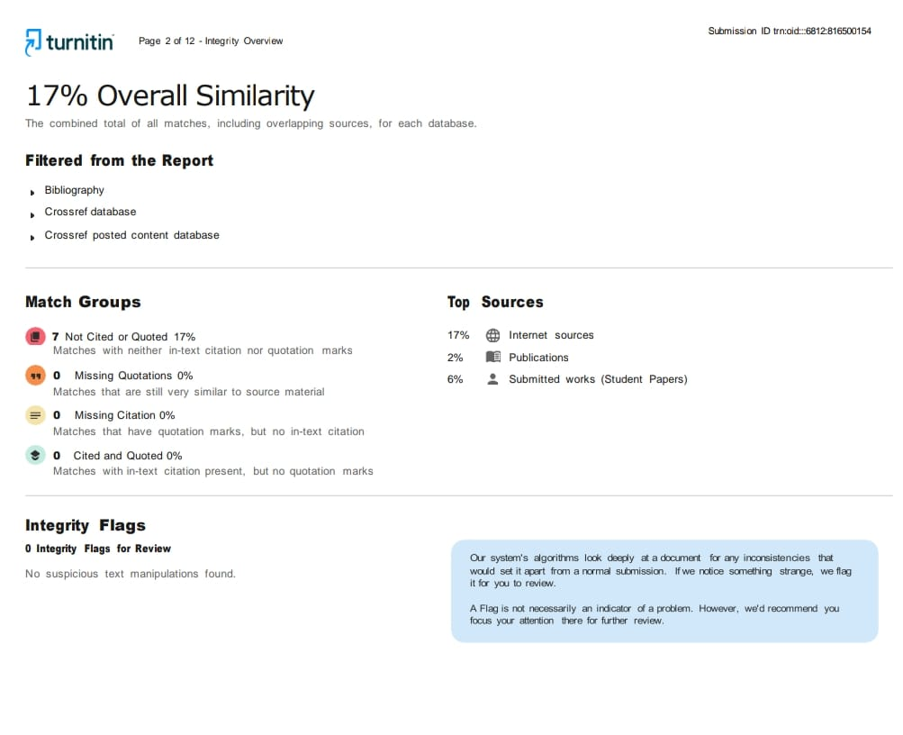
PLAGIARISM AND ACCEPTANCE

Slide 26
Reference or Bibliography:
Bajwa, S. G., P. Bajcsy, P. Groves, and L. F. Tian. 2004. Hyperspectral image data mining for band selection in agricultural applications. Trans. ASAE 47(3): 895-907. Caltepe, Z., T. C. Pearson, and A. E. Cetin. 2004. Identification of insect-damaged wheat kernels using transmittance images. Electronic Letters 41(5): 23-24.
Dowell, F. E., T. N. Boratynski, R. E. Ykema, A. K. Dowdy, and R. T. Staten. 2002. Use of optical sorting to detect wheat kernels infected with Tilletia indica. Plant Disease 86(9): 1011-1013.
Han, J., and M. Kamber. 2001. Data Mining: Concepts and Techniques. San Francisco, Cal.: Morgan Kaufmann.
Lawrence, K. C., W. R. Windham, B. Park, and R. J. Buhr. 2003. A hyperspectral imaging system for identification of faecal and ingesta contamination on poultry carcasses. J. Near Infrared Spec. 11(4): 269-281.
Lestander, T. A., R. Leardi, and P. Geladi. 2003. Selection of near-infrared wavelengths using genetic algorithms for the determination of seed moisture content. J. Near Infrared Spec. 11(4): 433-446.
Mehl, P. M., K. Chao, M. Kim, and Y. R. Chen. 2002. Detection of defects on selected apple cultivars using hyperspectral and multispectral image analysis. Applied Eng. in Agric. 18(2): 219-226.
Pasikatan, M. C., and F. E. Dowell. 2002. Evaluation of high-speed color sorter for segregation of red and white wheat. Applied Eng. in Agric. 19(1): 71-76.
Pearson, T. C., M. A. Doster, and T. J. Michailides. 2001. Automated detection of pistachio defects by machine vision. Applied Eng. in Agric. 17(5): 729-732.

